Slide 1

Azure Powershell 101
@JONATHANMEDD
@UKSthCoastPSUG

Slide 2
DEMO Heavy
All the examples are in my GitHub repo, so no need to try and copy them down
https://github.com/jonathanmedd/Presentations/tree/master/PowerShell/Azure%20PowerShell%20101

Slide 3
OMG – how did this ever get through QA

Slide 4
OMG – how did this ever get through QA
Hardly any pipeline support
The help examples often don’t work or don’t exist
The error messages are often hopeless
Everything seems slow to create anything in Azure

Slide 5
There is hope!

Slide 6
In good hands
It’s on Github and they take PRs - https://github.com/Azure/azure-powershell
Monthly Community Call - https://www.youtube.com/channel/UCixf-wKu779TbQuNpvcVJwg
They are making progress, but a long way to go…..as well as keeping up with everything new in Azure
@twitchax
@cormacpayne

Slide 7
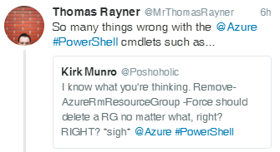
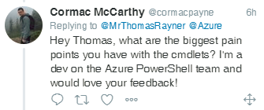
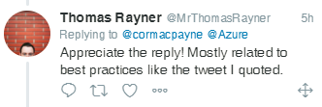
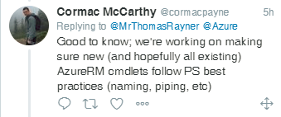
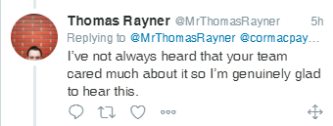
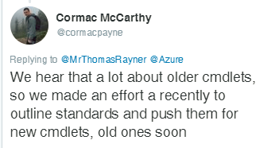
In good hands

Slide 8
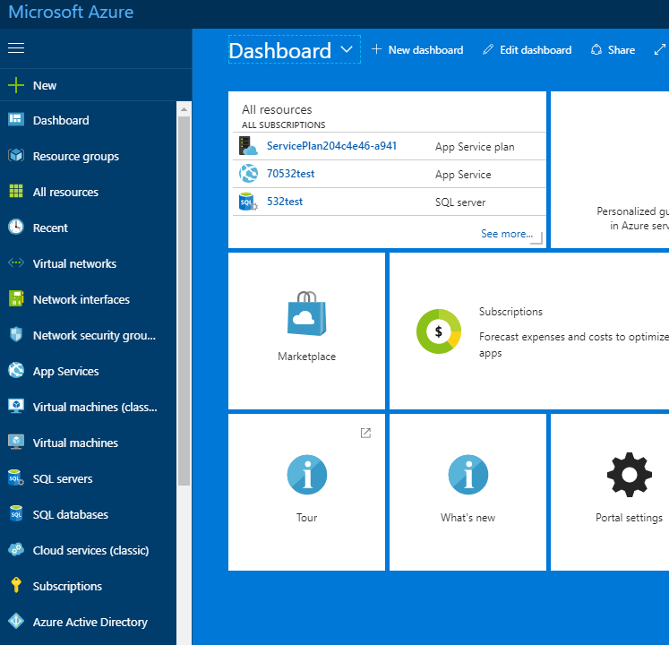
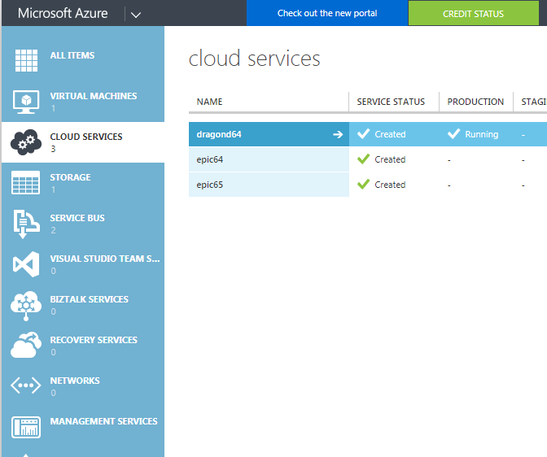
Resource manager vs classic portal

Slide 9
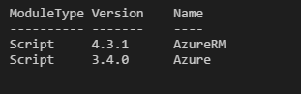
Resource manager vs classic PowerShell
You may find that it is possible to do the same things via either modules
Sometimes you may even need to use parts of both to do something very straightforward
http://www.jonathanmedd.net/2017/01/create-an-azure-storage-blob-container-with-powershell.html

Slide 10
DEMO
Login (yeah it actually needs a demo)
Create a VM
Create a Blob Storage Container
Create a SQL database

Slide 11
ARM templates
Github examples
https://github.com/Azure/azure-quickstart-templates
Note: this is in the Azure repo, not the PowerShell repo
- they don’t care what language you use
Demo

Slide 12
Powershell in azure cloud shell
https://channel9.msdn.com/Shows/Azure-Friday/PowerShell-in-Azure-Cloud-Shell
Demo

Slide 13
New Azure powershell experimental features
https://channel9.msdn.com/Shows/Azure-Friday/Experimental-cmdlets-in-Azure-PowerShell
Demo

Slide 14
SUMMARY
Give it a try and contribute where you can
https://github.com/jonathanmedd/Presentations/tree/master/PowerShell/Azure%20PowerShell%20101

